Slide 1
Edu2Job Predicting Job Roles from Educational Background
OVERVIEW OF THIS PROJECT AND MILESTONE 1

Slide 2
🧠 Project Overview: Predicting Suitable Job Roles from Education Details
🎯 Objective
The main goal of this project is to help students and professionals discover the most suitable job roles based on their education background and skills. Using Machine Learning (ML) and Data Analytics, the system analyzes the user’s academic details and predicts job roles that best match their profile.

Slide 3
💡 Problem Statement
Many students struggle to choose the right career after graduation because they:
Don’t know which jobs fit their qualifications.
Are unaware of other roles that match their skills.
Lack career guidance based on real data.
This project bridges that gap by creating a data-driven recommendation system that connects education → career path automatically.

Slide 4
⚙️ How the System Works
User Authentication & Profile Management
Users sign up securely (using JWT or Google Login).
Each user has a personal dashboard that saves their profile and prediction history.
Education Details Input
The user enters their academic data such as:
Degree, specialization, CGPA, year of graduation, certifications, etc.
The data is cleaned and prepared (encoded, normalized) for ML processing.
Job Role Prediction
The system uses a trained Machine Learning model (like Random Forest or XGBoost) to predict the top 3–5 job roles suitable for the user.
The results include confidence scores and explanations (e.g., skills match, overlapping domains).
Visualization & Insights
The dashboard shows graphs and charts that highlight:
Trends between education and job outcomes.
Which degrees commonly lead to which job roles.
Users can compare their data with others having similar profiles.
Admin Controls
Admins can upload new training datasets.
Retrain the ML model for better accuracy.
Manage users and handle flagged or incorrect predictions.

Slide 5
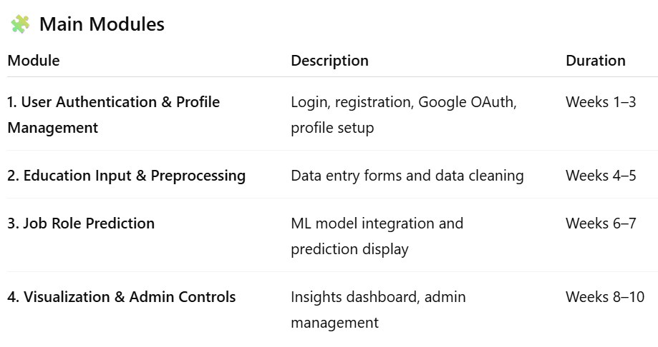

Slide 6
🧾 Expected Outcomes
✅ A working system that predicts job roles based on education details. ✅ A user-friendly dashboard showing predictions and insights. ✅ Admin tools for managing data, retraining models, and reviewing predictions. ✅ Secure, role-based login for users and admins.

Slide 7
🌍 Real-World Applications
Career counseling platforms and college placement systems.
HR analytics tools for recruitment.
Educational institutions guiding students on career paths.
Online learning platforms recommending courses for specific job roles.

Slide 8
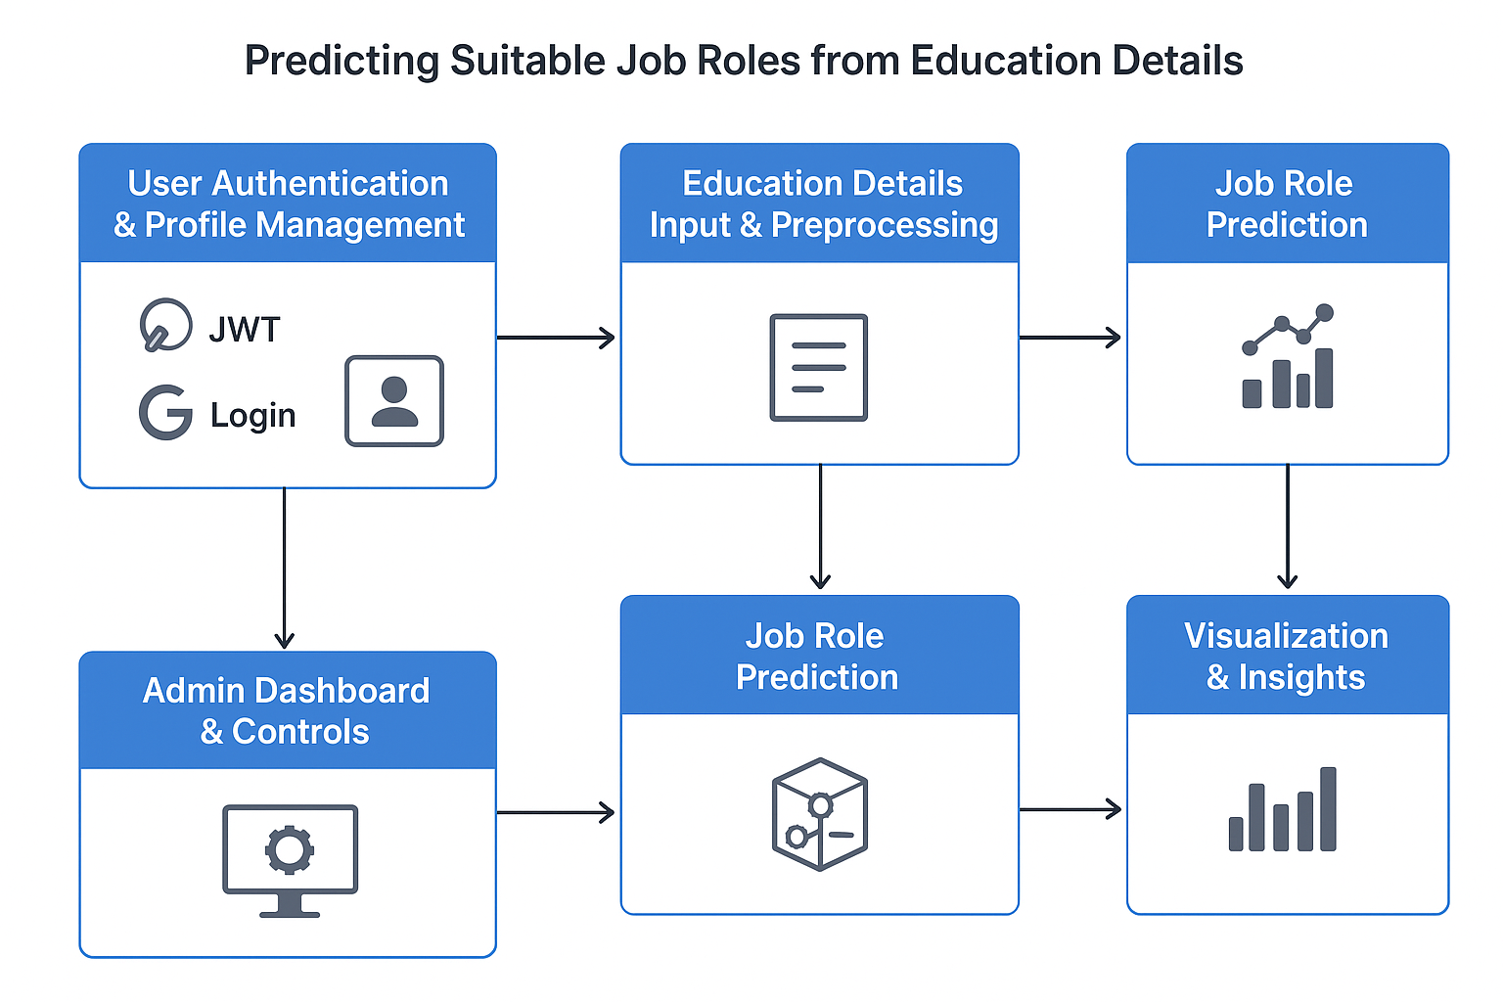

Slide 9
🎯 Milestone 1 (Weeks 1–3): User Authentication and Profile Management
This is the starting phase of the project where the main goal is to set up a secure user system. Students will build the foundation that allows users to log in, create profiles, and manage their personal and academic data.

Slide 10
🧩 Main Objectives
User Registration & Login
Implement JWT (JSON Web Token) authentication for secure login.
Add Google OAuth for one-click sign-in using Google accounts.
Ensure passwords and user data are securely stored.
Profile Management
After login, users should have a dashboard that shows:
Their personal details
Their history of job predictions (saved from later milestones)
Enable users to edit or update their academic and personal information.
Role-Based Access
Implement access control so that:
Users can input education data and get predictions.
Admins can manage datasets, monitor user activity, and retrain models (in later milestones).

Slide 11
🧠 Expected Output by End of Milestone 1
A fully functional login system using JWT and/or Google OAuth.
A user profile page that stores and displays:
Basic info (name, email)
Academic info (degree, specialization, etc.)
Secure data handling (no plain-text passwords, session security).
A dashboard layout ready for integration with later modules (like job prediction results).

Slide 12
✅ Evaluation Criteria (as per document)
To successfully complete Milestone 1:
Registration and login should work correctly and securely.
JWT and Google OAuth must both be implemented.
User data (profile and login info) should be saved in the database and retrievable.

Slide 13
🧰 Technologies Typically Used
Frontend: React / HTML / CSS
Backend: Node.js or Python (Flask/Django)
Database: MongoDB / MySQL / PostgreSQL
Authentication: JWT, Google OAuth API

Slide 14
🗓️ Milestone 1: User Authentication & Profile Management
Goal: By the end, students should be able to build a secure login system (JWT + Google OAuth), store user details, and create a profile/dashboard.

Slide 15
Day 1 – Project Introduction & Setup
Explain overall project idea & how Milestone 1 fits into the final system.
Discuss the importance of authentication and user roles.
Install required tools:
Backend: Node.js / Python (Flask or Django)
Frontend: React / HTML-CSS-JS
Database: MongoDB / MySQL
Task: Set up project folder structure and Git repo.

Slide 16
🎯 Objective for the Day
To help students understand what the project is about, how Milestone 1 fits into the full system, and to get their development environment ready (backend, frontend, and database setup).

Slide 17
🧠 1. Explain the Overall Project Idea
The project is titled “Predicting Suitable Job Roles from Education Details.” Its main goal is to analyze a user’s educational background (degree, specialization, CGPA, certifications, etc.) and predict the most suitable job roles for them using Machine Learning.
The system will:
Take user education details as input.
Process the data and run it through a trained ML model.
Predict top 3–5 job roles with confidence scores.
Show the results on a dashboard with graphs and insights.

Slide 18
🧩 2. How Milestone 1 Fits into the Whole Project
Milestone 1 lays the foundation for the entire project. Before predicting anything, the system must:
Identify who the user is.
Store their profile and academic details securely.
Allow users to log in (via email or Google) and access their dashboard.
So, in this milestone, the focus is on User Authentication & Profile Management:
Implement login and signup with JWT (secure tokens).
Integrate Google OAuth for easy access.
Create a user dashboard to store and view their data.
Once this is done, later milestones can build on top of it (data input, prediction model, and visualization).

Slide 19
🔐 3. Importance of Authentication and User Roles
Explain to students why authentication is crucial:
It ensures data security — only authorized users can access their profiles.
It helps maintain personalized data (each user’s predictions are unique).
It enables role-based access — e.g.:
User: Can input education details and see job suggestions.
Admin: Can upload training data, manage predictions, retrain the model, and monitor users.
This sets the stage for a secure and multi-user system.

Slide 20
⚙️ 4. Install Required Tools
Help students install or verify the following:
🧰 Backend
Choose either:
Node.js + Express (JavaScript-based backend), or
Python (Flask/Django) for Python lovers.
Purpose: Handles authentication logic, user management, and APIs.
💻 Frontend
React.js (recommended) or HTML/CSS/JavaScript for a simple interface. Purpose: To create user-friendly login, signup, and profile pages.
🗄️ Database
Choose based on preference:
MongoDB (NoSQL) – Flexible, good for quick development.
MySQL/PostgreSQL (SQL) – Structured, good for relational data.
Purpose: To store user credentials, profile details, and history.

Slide 21
🧱 5. Task for Students
Hands-on Setup:
Create a main project folder (e.g., job-role-predictor/).
Inside it, make subfolders:
job-role-predictor/
├── backend/
├── frontend/
├── database/
└── README.md

Slide 22
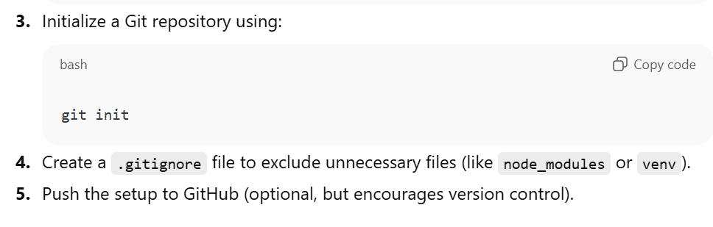

Slide 23
🧩 6. Expected Outcome of Day 1
By the end of the session, students should: ✅ Understand the complete project workflow. ✅ Know what Milestone 1 will achieve. ✅ Have a basic project structure ready. ✅ Have Node.js/Python, React, and MongoDB/MySQL installed. ✅ Be familiar with using Git for version control.

Slide 24
Day 2 – Backend Basics & Database Design
Explain how backend APIs work (client-server model).
Teach database schema for users:
{
"id": 1,
"name": "John Doe",
"email": "john@example.com",
"password": "hashed_password",
"role": "user",
"education": {}
}
Introduce REST APIs (register, login).
Task: Create /register and /login endpoints (dummy response).

Slide 25
🎯 Objective for the Day
To help students understand how the backend of a web application works, how data is stored and accessed through APIs, and how to design a user database schema for authentication. By the end of this session, students should be able to create basic backend routes for user registration and login.

Slide 26
⚙️ 1. Explain How the Backend Works (Client–Server Model)
The frontend (client) is what the user sees — login pages, forms, dashboards, etc.
The backend (server) handles logic behind the scenes — verifying users, saving data, fetching results, etc.
When a user clicks “Login” or “Register,” the frontend sends a request to the backend using an API.
The backend processes it and sends back a response (success or error).
🧩 Example Flow:
User fills the signup form on frontend.
Data (name, email, password) is sent to backend via a POST request (/register).
Backend stores the user info in the database.
Backend sends a confirmation message (“User Registered Successfully”).

Slide 27
🗃️ 2. Teach Database Schema for Users
Students should understand how data is structured and stored.
Here’s a simple User Schema example (for MongoDB or JSON format):
{
"id": 1,
"name": "John Doe",
"email": "john@example.com",
"password": "hashed_password",
"role": "user",
"education": {}
}
🔍 Field Explanation
id: Unique identifier for each user (auto-generated).
name: User’s full name.
email: Used for login and unique identification.
password: Stored in a hashed form for security (not plain text).
role: Defines access type (user or admin).
education: Placeholder for education details (will be filled later).

Slide 28
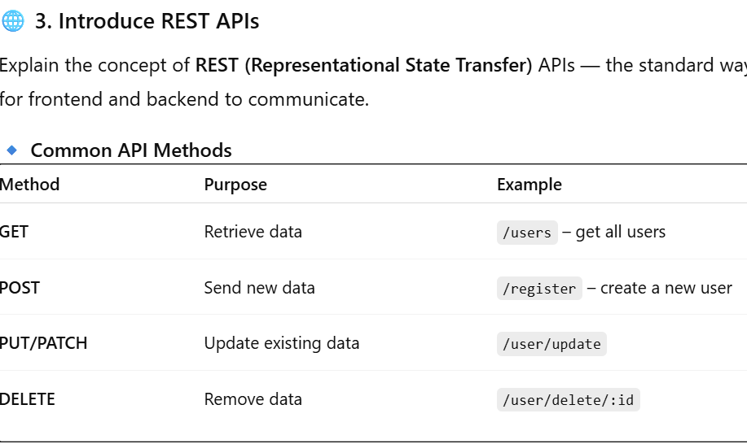

Slide 29
For today’s class, focus on two key APIs:
POST /register → for new user signup
POST /login → for verifying existing users

Slide 30
🧩 5. Task for Students
Create a simple backend project (Node.js + Express OR Python Flask).
Set up routes for /register and /login.
Test endpoints using Postman or browser.
Show “dummy response” working properly.

Slide 31
✅ Expected Outcome of Day 2
By the end of this session, students should:
Understand how client-server communication works.
Know what REST APIs are and how to define them.
Have a user schema structure ready for database storage.
Successfully create and test /register and /login dummy APIs.

Slide 32
Day 3 – JWT Authentication (Theory + Demo)
Explain what JWT is, why it’s used (token-based authentication).
Show how to:
Generate token on successful login.
Verify token for protected routes.
Demo: Register → Login → Receive JWT → Access protected profile route.
Task: Students implement JWT in backend.

Slide 33
🎯 Objective
To help students understand what JWT (JSON Web Token) is, why it’s important for secure login systems, and how to implement it in the backend to protect routes like a user’s profile page.
By the end of this session, students should be able to: ✅ Generate a JWT after login ✅ Verify it before accessing protected APIs

Slide 34
🧠 1. What is JWT (JSON Web Token)?
JWT stands for JSON Web Token — it’s a secure way to authenticate users in modern web applications without storing login sessions on the server.
When a user logs in successfully:
The backend generates a token (JWT).
That token is sent back to the frontend.
The frontend stores it (usually in localStorage).
On every future request, the token is sent to the backend for verification.
If the token is valid → access is granted; otherwise → denied.

Slide 35
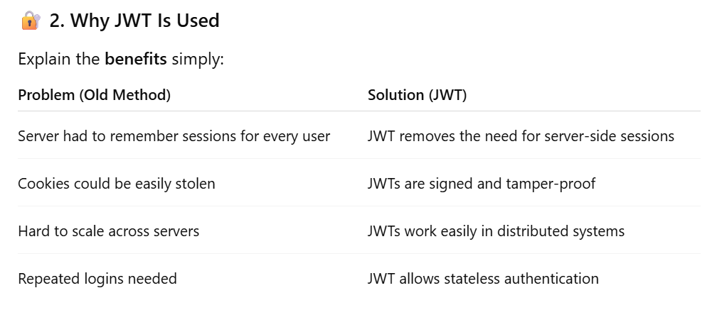

Slide 36
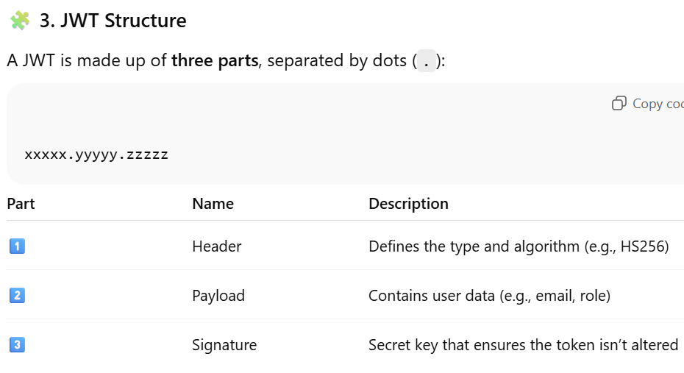

Slide 37
⚙️ 4. How JWT Authentication Works (Flow Example)
User logs in with email and password.
Backend verifies credentials in database.
Backend creates a JWT (using a secret key).
Token is sent back to the frontend.
Frontend stores it in browser localStorage.
For future requests (like /profile), frontend sends the token in the header:
Authorization: Bearer <token>
Backend verifies the token before giving access to the route.

Slide 38
💻 5. Demo Example (Node.js)
🧱 Step 1: Install Required Packages
npm install express jsonwebtoken body-parser

Slide 39
🧱 Step 2: Generate JWT on Login
const express = require("express");
const jwt = require("jsonwebtoken");
const app = express();
app.use(express.json());
const SECRET_KEY = "mySecret123"; // keep this secret and safe!
app.post("/login", (req, res) => {
const { email, password } = req.body;
// Dummy check for demo
if (email === "user@example.com" && password === "1234") {
const token = jwt.sign({ email: email, role: "user" }, SECRET_KEY, { expiresIn: "1h" });
res.json({ message: "Login successful", token: token });
} else {
res.status(401).json({ message: "Invalid credentials" });
}
});

Slide 40
🧱 Step 3: Verify JWT for Protected Route
function verifyToken(req, res, next) {
const authHeader = req.headers['authorization'];
const token = authHeader && authHeader.split(' ')[1];
if (!token) return res.status(403).json({ message: "No token provided" });
jwt.verify(token, SECRET_KEY, (err, user) => {
if (err) return res.status(403).json({ message: "Invalid token" });
req.user = user;
next();
});
}
app.get("/profile", verifyToken, (req, res) => {
res.json({ message: "Welcome to your profile", user: req.user });
});
app.listen(5000, () => console.log("Server running on port 5000"));

Slide 41
🧩 Demo Flow:
Login → receive token.
Copy token and send it in header for /profile.
Server verifies token and gives access.

Slide 42
🧰 7. Student Task
Implement JWT authentication in their own backend project.
Create a protected /profile route that requires a valid token.
Test login and token validation using Postman.

Slide 43
✅ Expected Outcome of Day 3
By end of class, students should:
Understand how JWT works conceptually.
Generate and verify JWTs using secret keys.
Implement a protected API route using JWT verification middleware.
Test authentication flow successfully.

Slide 44
Day 4 – Frontend Integration (Login & Signup Pages)
Explain frontend-backend communication via API calls (fetch/axios).
Build simple Login and Signup forms.
Connect forms with backend API.
Task: Test login & signup flow end-to-end.

Slide 45
Goal:
Students will understand how frontend talks to backend using API calls and build Login + Signup pages connected to the backend.

Slide 46
1️⃣ What is Frontend–Backend Communication?
A web application is divided into two parts:
Frontend (Client Side)
What the user sees
Built using HTML, CSS, JavaScript, React, Angular, etc.
Sends requests (data) to backend
Displays results (JSON → UI)
Backend (Server Side)
Built using Flask / Django / Node.js / FastAPI
Receives requests
Processes logic (authentication, DB saving, ML prediction)
Sends back response in JSON format

Slide 47
2️⃣ What is an API?
API (Application Programming Interface) It is a communication method that allows frontend and backend to talk.

Slide 48
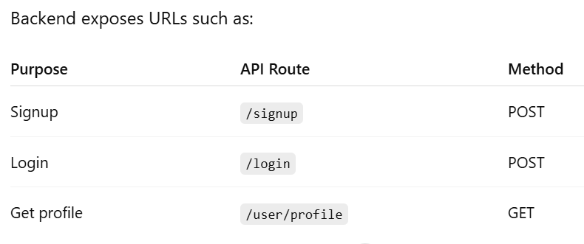

Slide 49
3️⃣ What is JSON?
Most API responses are sent in JSON format.
Example response:
{
"message": "Login successful",
"token": "asdjh1238yqwudb"
}

Slide 50
4️⃣ What Happens During Signup?
User fills form → frontend sends data → backend stores in database.
Steps:
User enters email, username, password
Click submit
Frontend captures data
Sends to backend (POST request)
Backend validates
Saves user data
Returns: "User created successfully"

Slide 51
5️⃣ What Happens During Login?
User enters email + password
Frontend → send POST request
Backend checks credentials
If correct, it returns a JWT token
Frontend saves token in localStorage
All protected pages require token

Slide 52
6️⃣ What is JWT (JSON Web Token)?
A secure way to keep a user logged in.
Token stores user identity (email/userID)
Saved in browser
Sent to backend on every secured request
Example JWT:
eyJhbGciOiJIUzI1NiIsInR5cCI6IkpXVCJ9...

Slide 53
7️⃣ Why JWT?
✔ Secure ✔ Stateless ✔ Used in most modern applications ✔ Easy to verify user without DB lookup every time

Slide 54
1️⃣ Frontend–Backend Communication (fetch / axios)
Your frontend (HTML/JS/React) must send data to backend APIs such as:
POST /signup → create user
POST /login → verify user + return JWT token
How API Calls Work
Frontend → sends request with user data Backend → processes → returns JSON response

Slide 55
Work flow:
Signup Form → POST data → Backend saves user → Response: "User created"
Login Form → POST data → Backend checks user → Response: token

Slide 56
2️⃣ Simple Signup Form (HTML + JS)
HTML
<form id="signupForm">
<input type="text" id="username" placeholder="Enter username" required />
<input type="email" id="email" placeholder="Enter email" required />
<input type="password" id="password" placeholder="Enter password" required />
<button type="submit">Signup</button>
</form>
<p id="result"></p>

Slide 57
JS (using fetch)
document.getElementById("signupForm").addEventListener("submit", async (e) => {
e.preventDefault();
const data = {
username: document.getElementById("username").value,
email: document.getElementById("email").value,
password: document.getElementById("password").value
};
const res = await fetch("http://localhost:5000/signup", {
method: "POST",
headers: {"Content-Type": "application/json"},
body: JSON.stringify(data)
});
const result = await res.json();
document.getElementById("result").innerText = result.message;
});

Slide 58
3️⃣ Simple Login Form (HTML + JS)
HTML
<form id="loginForm">
<input type="email" id="email" placeholder="Enter email" required />
<input type="password" id="password" placeholder="Enter password" required />
<button type="submit">Login</button>
</form>
<p id="loginMessage"></p>

Slide 59
5️⃣ End-to-End Flow Students Should Test
✔ Signup →
Fill form
Data goes to backend
User gets success message
✔ Login →
Enter valid credentials
Backend returns JWT token
Token stored in localStorage
✔ After login →
Test protected API:
fetch("http://localhost:5000/user/profile", {
headers: { "Authorization": "Bearer " + localStorage.getItem("token") }
});
If token works → backend returns profile details.

Slide 60
6️⃣ Student Tasks (Day 4 Tasks)
Task 1:
Create Login + Signup pages (HTML/CSS)
Task 2:
Connect both forms to backend using fetch/axios
Task 3:
Store JWT token in localStorage after login
Task 4:
Test complete flow end-to-end:
Signup → Login → Access protected route
Task 5 (Optional Advanced):
Show an alert if:
Wrong password
User not found
Weak password

Slide 61
7️⃣ Expected Output After Today
✔ Working signup screen ✔ Working login screen ✔ Backend receives data ✔ JWT saved in frontend ✔ User can access protected page after login

Slide 62
Day 5 – Profile Management Structure
Explain concept of user dashboard and profile data storage.
Design profile page wireframe (name, email, education info, history).
Backend: Create endpoint to fetch & update profile.
Task: Store logged-in user info locally (session or JWT token).

Slide 63
🎯 Goal of Today
Students will learn:
What is a User Dashboard
How user profile data is stored
How to design a Profile Page UI
How to create backend fetch/update profile APIs
How to store user login info using JWT/sessio

Slide 64
1️⃣ What is a User Dashboard?
A User Dashboard is the main homepage after login. It displays:
User identity (name, email)
Education details
Job prediction history
Options to update profile
Logout button
Why do we need a dashboard?
✔ Personalized experience ✔ Shows user data ✔ Allows updating information ✔ Required for projects with authentication ✔ Helps connect multiple modules (education, prediction, history)

Slide 65
2️⃣ How is Profile Data Stored?
A user profile typically stores:
🔹 Personal Info
Name
Email
Profile picture (optional)
🔹 Education Info
Degree
Specialization
CGPA
Certifications
🔹 History
Past job predictions
Date/time of each prediction
Where is this stored?
✔ Database – SQL/SQLite/MongoDB ✔ Linked to user using user_id ✔ Fetched using JWT authentication

Slide 66
3️⃣ How Frontend Knows Which User is Logged In?
When login is successful:
Backend returns a JWT token
Frontend stores the token:
Option 1 — localStorage (most common):
localStorage.setItem("token", jwtToken)
Option 2 — sessionStorage (expires on tab close):
sessionStorage.setItem("token", jwtToken)
This token is used to fetch user profile:
Authorization: Bearer <token>

Slide 67
--------------------------------------------------
| USER PROFILE DASHBOARD |
--------------------------------------------------
| Profile Picture (optional) |
| |
| Name: ________________________ |
| Email: ________________________ |
| |
|--------------- Education Information ------------|
| Degree: ______________________ |
| Specialization: _______________ |
| CGPA: _________________________ |
| Certifications: _______________ |
| |
|--------------- Prediction History ---------------|
| 1. Data Analyst – 89% (12 Oct 2025) |
| 2. ML Engineer – 76% (10 Oct 2025) |
| |
| [Update Profile Button] |
| [Logout Button] |
--------------------------------------------------

Slide 68
BACKEND APIs (FETCH + UPDATE PROFILE)
1️⃣ GET Profile API
Used to fetch data from database using JWT token.
2️⃣ UPDATE Profile API
Used when user edits education or personal info.
FRONTEND (Fetching User Profile)
JavaScript

Slide 69
Storing Logged-In User Info
Method | Persistence | Best Use
localStorage | Until manually cleared | Login sessions
sessionStorage | Clears on tab close | Single-session apps
Cookies | Controlled expiry | Secure production apps

Slide 70
🔹 Task 1: Create Profile Page Layout
Fields to include:
Name
Email
Degree
Specialization
CGPA
History section
🔹 Task 2: Fetch User Profile Using Token
Use GET /user/profile Store data in page fields.
🔹 Task 3: Implement Update Button
On click:
Collect form data
Send to POST /user/update
🔹 Task 4: Store Login Info
Store JWT token in:
localStorage or
sessionStorage
🔹 Task 5 (Optional):
Show alert if no token found:

Slide 71
Expected Output by End of Day
✔ Students understand concept of dashboard ✔ Simple UI wireframe designed ✔ Backend profile fetch/update APIs created ✔ Frontend loads profile dynamically ✔ JWT stored & used for authentication ✔ Update profile working end-to-end

Slide 72
🔹 Week 2: Dashboard, Google Login, and Final Integration
Day 6 – Google OAuth Integration
Explain OAuth 2.0 flow (Google Sign-In).
Demo integrating Google Login API in frontend.
Backend: Verify Google token & create/update user in DB.
Task: Add “Login with Google” button and connect it.

Slide 73
Goal: Teach students how to integrate Google Sign-In using OAuth 2.0 with frontend + backend validation.

Slide 74
1️⃣ What is OAuth?
OAuth 2.0 is a secure authentication system that allows users to log in to your app using another trusted provider such as:
Google
Facebook
GitHub
LinkedIn
Instead of creating a new password, users simply authenticate through Google.

Slide 75
2️⃣ Why Google OAuth?
✔ No need to set passwords ✔ Faster login ✔ More secure ✔ Verified email (reduces fake accounts) ✔ Easy user onboarding

Slide 76
3️⃣ OAuth 2.0 Flow (Simplified)
User → Clicks "Login with Google"
↓
Google login popup appears
↓
User selects Google account
↓
Google returns an ID Token (JWT)
↓
Frontend sends Google token to backend
↓
Backend verifies token with Google Server
↓
If valid → create user in DB + return our JWT
↓
User logged in

Slide 77
4️⃣ What is a Google ID Token?
A JWT provided by Google
Contains user data: name, email, picture
Must be verified by backend to ensure authenticity
Example ID token (truncated):
eyJhbGciOiJSUzI1NiIsImtpZCI6IjRjZjgyODk1OTk2Y2E5...

Slide 78
FRONTEND: Google Login Button
1️⃣ Load Google Identity API
Add this script tag in your HTML:
<script src="https://accounts.google.com/gsi/client" async defer></script>
2️⃣ Add Google Login Button
<div id="g_id_onload"
data-client_id="YOUR_GOOGLE_CLIENT_ID"
data-callback="handleGoogleLogin">
</div>
<div class="g_id_signin"
data-type="standard"
data-size="large"
data-theme="outline"
data-text="signin_with"
data-shape="rectangular">
</div>

Slide 79
3️⃣ Handle Google Login Response
Google returns a JWT token (credential):
function handleGoogleLogin(response) {
const googleToken = response.credential;
// Send to backend for verification
fetch("http://localhost:5000/google-login", {
method: "POST",
headers: { "Content-Type": "application/json" },
body: JSON.stringify({ token: googleToken })
})
.then(res => res.json())
.then(data => {
localStorage.setItem("token", data.token);
alert("Login Successful!");
window.location.href = "dashboard.html";
});
}

Slide 80
BACKEND: Verify Google Token (Flask Example)
Install library
pip install google-auth
Verify Token in Backend

Slide 81
FULL LOGIN FLOW (Student-Friendly Diagram)
[Frontend] [Backend]
-------------------------------------------------------------
User clicks Google Login
→ Google returns ID token
ID token → sent to backend via POST /google-login
↓
Verify token with Google servers
↓
Valid? → Create/Update user in DB
↓
Backend returns OUR JWT (app's token)
↓
Frontend stores token → localStorage
↓
User logged into dashboard

Slide 82
STUDENT TASKS (Day 6 Tasks)
🔹 Task 1: Add Google Login button
Add Google Identity script
Add Google Sign-in div
Add callback function
🔹 Task 2: Connect frontend with backend
Capture Google token
POST it to /google-login
🔹 Task 3: Store final JWT token
Save in localStorage
Redirect to dashboard
🔹 Task 4: Test End-to-End
Google Login → backend verification → dashboard
Ensure no password required
Test with multiple accounts
🔹 Optional Task (Advanced)
Show user’s:
Google name
Google profile picture
Google email on the dashboard.

Slide 83
Expected Output After Today's Class
✔ Google Login button working ✔ User can log in without password ✔ Backend verifies Google token ✔ User entry created/updated in DB ✔ User redirected to dashboard with JWT ✔ No password stored locally → more secure

Slide 84
Day 7 – Profile Editing & Data Update
Teach PUT/PATCH API methods for updating user info.
Add “Edit Profile” feature.
Task: Students update academic fields (degree, specialization, etc.) and save to DB.

Slide 85
Goal: Teach students how to edit profile data and update it in the database using PUT / PATCH methods.

Slide 86
1️⃣ Why Do We Need Profile Editing?
Every user should be able to update their:
Name
Degree
Specialization
CGPA
Certifications
Contact information
This maintains accurate data and improves prediction quality.

Slide 87
2️⃣ What Are PUT & PATCH Methods?
✔ PUT (Complete Update)
Replaces the entire object
Sends all fields
If one field is missing, it may be set to null
Example: updating profile with all new data
Example:
PUT /user/update
Body:
{
"name": "New Name",
"degree": "B.Tech",
"cgpa": "8.9"
}

Slide 88
✔ PATCH (Partial Update)
Updates only the fields you send
Best for small changes
Does not remove missing fields
More commonly used in profile editing
Example:
PATCH /user/update
Body:
{
"cgpa": "9.1"
}

Slide 89
3️⃣ Why PATCH is Preferred for Profile Editing?
✔ Safer ✔ Fewer errors ✔ Only updates changed fields ✔ Does not overwrite other values

Slide 90
UI/UX: Edit Profile Workflow
Typical Flow:
User clicks “Edit Profile”
↓
Form fields become editable
↓
User updates details (degree, specialization, cgpa)
↓
Click Save
↓
Frontend sends PUT/PATCH request to backend
↓
Backend updates database
↓
UI shows “Profile updated successfully”

Slide 91
1️⃣ Optimistic UI update
Before backend response:
Show “Saving...”
Disable “Save” button
Improve UX
2️⃣ Validation examples
Check before sending:
CGPA must be 0–10
Degree must not be empty
Specialization must have min 3 letters
3️⃣ Security
Update route must always require JWT token
Users can update only their own profile

Slide 92
🔹 Task 1 — Create Edit Profile Form
Fields required:
Name
Degree
Specialization
CGPA
🔹 Task 2 — Implement PATCH Request
Send updated fields only.
🔹 Task 3 — Save updates to DB
Database must reflect new:
Degree
Specialization
CGPA
🔹 Task 4 — Show Success Message
"Profile updated successfully!"

Slide 93
Expected Outcome After Day 7
✔ Students know PUT vs PATCH ✔ UI for editing profile created ✔ Backend update API working ✔ Data updated in database successfully ✔ JWT-secured update flow implemented ✔ Students can modify academic details

Slide 94
Day 8 – Dashboard UI Development
Build basic dashboard layout (React components / HTML cards).
Display:
User profile info.
Placeholder for future job prediction history.
Task: Students design and style their dashboards.

Slide 95
Goal: Students will build a Dashboard UI that displays profile data and placeholders for prediction history.

Slide 96
What is a Dashboard?
A Dashboard is the central page a user sees after logging in. It summarizes all important information in a clean and visual format.
A good Dashboard must:
✔ Look organized ✔ Show important data clearly ✔ Have consistent layout ✔ Be easy to navigate ✔ Provide placeholders for upcoming modules

Slide 97
Dashboard Structure (What to Include)
Your dashboard should have at least three major sections:
1️⃣ Header / Navbar
"Welcome, Username"
Logout button
Logo / App Name
2️⃣ User Profile Section
Display:
Name
Email
Degree
Specialization
CGPA
(Optional) Google profile picture
3️⃣ Placeholder Sections
These will be completed in upcoming days.
👉 Future Job Prediction History
Show list of past predictions
Present confidence scores
Display dates
👉 Future: Education Insights
Graphs
Career suggestions
Skill gap analysis

Slide 98
---------------------------------------------------------
| USER DASHBOARD |
|---------------------------------------------------------|
| Header |
| - Logo | Welcome [User Name] | Logout |
|---------------------------------------------------------|
| Profile Card |
| ------------------------------ |
| | Name: John Doe | |
| | Email: john@gmail.com | |
| | Degree: B.Tech | |
| | CGPA: 8.5 | |
| ------------------------------ |
| Job Prediction History (Placeholder) |
| ----------------------------------------------------- |
| | - No predictions yet |
| | (This will be updated on Day 10–12) |
| ----------------------------------------------------- |
---------------------------------------------------------

Slide 99
React Version (Recommended Modern Approach)
React Component Structure
Dashboard
├── Header
├── ProfileCard
└── PredictionHistory
1️⃣ Dashboard.jsx
import React from "react";
import Header from "./Header";
import ProfileCard from "./ProfileCard";
import PredictionHistory from "./PredictionHistory";
export default function Dashboard() {
return (
<div className="dashboard-container">
<Header />
<div className="content">
<ProfileCard />
<PredictionHistory />
</div>
</div>
);

Slide 100
STUDENT TASKS (Day 8)
✔ Task 1 — Create Dashboard Layout
Must include:
Header
Profile Card
Prediction History placeholder
✔ Task 2 — Apply CSS Styling
Clean spacing
Rounded cards
Consistent fonts
Simple color theme
✔ Task 3 — Fetch Profile Data Dynamically
Using:
GET /user/profile
✔ Task 4 — Add Responsive Design (optional)
Use flex/grid
Make cards adjust on smaller screens
✔ Task 5 (Optional Advanced)
Add profile picture
Add sidebar navigation
Add animated transitions
Display Google account picture if logged in via Google

Slide 101
Expected Output After Day 8
✔ Students build a clean dashboard UI ✔ Profile card displays user info ✔ Placeholder card ready for prediction history ✔ Dashboard layout works across devices ✔ Students understand component-based UI design

Slide 102
Day 9 – Testing & Security
Discuss input validation, password hashing (bcrypt), and error handling.
Test full flow: Register → Login → Profile → Edit → Logout.
Task: Debug and secure API endpoints (check JWT before access).

Slide 103
Goal: Strengthen application reliability by adding security + validations + error handling, and test the entire user flow end-to-end.

Slide 104
Why Testing & Security Matter
Building features is not enough. A good application must be:
✔ Safe ✔ Error-free ✔ Validated ✔ Protected from unauthorized access

Slide 105
INPUT VALIDATION
What is Input Validation?
Validating user inputs before saving to the database.
Why?
Prevents broken data
Avoids SQL/NoSQL injection
Prevents empty fields
Ensures clean data for ML model
Examples
1️⃣ Frontend Validation
Email format
Password length
CGPA between 0 and 10
Degree not empty
2️⃣ Backend Validation
Always validate again on server:

Slide 106
PASSWORD HASHING (bcrypt)
❌ Never store plain passwords
Example of insecure storage:
password: "12345"
✔ Use Hashing (bcrypt)
Hashing = one-way irreversible encryption.
Install bcrypt
pip install bcrypt
Sample code
import bcrypt
password = data["password"].encode("utf-8")
hashed = bcrypt.hashpw(password, bcrypt.gensalt())
# Save hashed password in DB
Checking password during login
if bcrypt.checkpw(input_password.encode("utf-8"), stored_hash):
# Password correct

Slide 107
ERROR HANDLING (Backend)
Why it matters:
Prevents app crashes
Gives user-friendly messages
Makes debugging easier

Slide 108
Good Errors
400 → Invalid input
401 → Unauthorized
404 → Not found
500 → Internal error

Slide 109
END-TO-END TESTING FLOW
Students must test entire application flow:
✔ Step 1: Register
Verify validation
Check that password is hashed in DB
✔ Step 2: Login
Correct password → success
Incorrect → show error
Token saved in localStorage
✔ Step 3: Dashboard → Profile
Show correct user info
No token → redirect to login
✔ Step 4: Edit Profile
Update degree/specialization/CGPA
Check field validations
✔ Step 5: Logout
Clear token
Redirect to login
Try opening dashboard again → should be blocked

Slide 110
TEST CASES FOR STUDENTS
Registration
Empty email → error
Short password → error
Duplicate email → error
Check password is not stored as plain text
Login
Wrong password → error
Correct login → returns JWT
Protected routes
Access profile without token → should return 401
Access with wrong token → should return 401
Profile update
Invalid CGPA → error
Blank degree → error
Security
Try modifying another user’s data → should fail

Slide 111
STUDENT TASKS (Day 9)
🔹 Task 1 — Add input validation (frontend + backend)
Validate:
Email
Degree
Specialization
CGPA
Password (min length)
🔹 Task 2 — Secure all login/registration routes
Hash passwords using bcrypt
Validate login credentials properly
🔹 Task 3 — Add JWT protection to sensitive APIs
Protect:
/user/profile
/user/update
prediction history
dashboard routes
🔹 Task 4 — Perform full flow testing
Register → Login → View Dashboard → Edit Profile → Logout → Test protection
🔹 Task 5 (Optional Advanced)
Add rate limiting
Add error logging
Add loading/spinner during API call
Add logout timer

Slide 112
Expected Output After Day 9
✔ Strong input validation ✔ Safe password hashing ✔ Working error-handling flow ✔ Protected APIs using JWT ✔ Full app flow tested end-to-end ✔ Students debug major issues ✔ App becomes production-ready in terms of security basics

Slide 113
Day 10 – Review & Evaluation
Recap what was learned:
JWT & OAuth
CRUD APIs
Profile management
Conduct short demo or mini-presentation by each student.
Give feedback and note areas to improve before Milestone 2.

Slide 114
RECAP OF WHAT STUDENTS HAVE LEARNED
1️⃣ Authentication & Security
JWT authentication flow
Google OAuth login
Token storage (localStorage/sessionStorage)
Securing API routes
Authentication middleware logic
2️⃣ CRUD APIs
POST → Signup / Login
GET → Fetch profile
PATCH / PUT → Update profile
DELETE (optional) → Remove history

Slide 115
3️⃣ Profile Management
Fetch user profile using token
Edit & update academic details
UI form validation
Save updates to database
Display updated info on dashboard
4️⃣ Dashboard UI Development
Component-based UI (React) or HTML template
Profile card
Prediction history placeholder
Styled cards, layouts, and structure

Slide 116
Quick Recap Session
Explain:
JWT flow diagram
OAuth flow
PATCH vs PUT
Dashboard → Profile → Edit → Logout cycle
Why validation & hashing matter

Slide 117
Student Demo / Mini Presentation
Each student shows:
Their Application Flow
✔ Register ✔ Login (Email or Google OAuth) ✔ Dashboard UI ✔ Profile page ✔ Editing academic data ✔ Logout

Slide 118
Evaluation Checklist (Mentor Observes)
Use this to evaluate each student's work.
🔹 Authentication & Security
JWT generated correctly
Token stored safely
Protected routes check token
Google OAuth functional
🔹 API Functionality
Signup API works end-to-end
Login API matches hashed password
Profile fetched correctly
Edit profile updates DB
🔹 UI/UX
Clean dashboard layout
Profile section readable
Organized components/cards
Basic styling applied
🔹 Code Quality
No hard-coded credentials
Clear naming
API errors handled
Validation checks present

Slide 119
Expected Outcome After Day 10
By end of the session, students should have:
✔ Working Register → Login → Dashboard → Profile → Edit → Logout flow ✔ Functional Google OAuth ✔ Fully tested and secure CRUD APIs ✔ Clean UI and working dashboard ✔ Ready-to-present week 2 project ✔ Clear understanding of improvements needed before Milestone submission

Slide 120
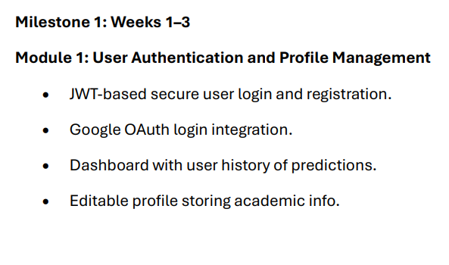

Slide 121
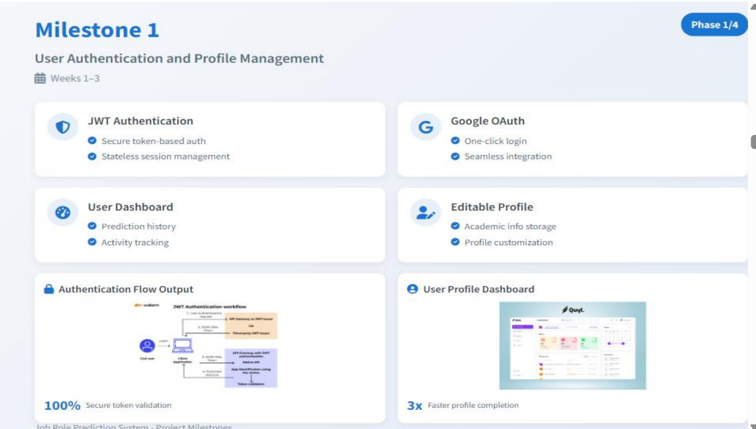

Slide 122
The above slide shows the sample overall output for milestone 1

